Slide 1

The Power of Cross-Platform Automated Web-Based Testing in CICD Pipelines
Jared Meredith
Test Automation and Digital QA Summit
#TAS20
US Season 2
October 8th, 2020

Slide 2

About me
12+ Years of IT Experience
  Currently @ TeamHealth
  Oak Ridge National Laboratory (ORNL)
  Oak Ridge Associated Universities (ORAU)
  Lincoln Memorial University
Executive Director of Architecture, Strategy & Governance
Founding Member, Knox Tech Council
LinkedIn – Website – Jared.Meredith@live.com
Other Interests
  Foodie on Yelp -> If you ever need a good referral in Knoxville, I’m your guy
  Love playing & recording music -> Electric & Acoustic Guitar, Bass, Piano, etc.
  Favourite games I’m playing -> Final Fantasy 7 Remake, NBA 2K21, and The Avengers

Slide 3
Context
With 30+ public websites that had a need for testing across multiple platforms and devices we had to evolve our QA practices from manually ran scripts on local computers and personally owned devices.
Through this innovation our IT teams were able to deliver a run book to automate QA testing across multiple devices and browsers while invoking it in an automated CICD pipeline.
Learn more about the power of this automation and the value it can bring to your IT organization:
1) Learn and understand the power of integrating cross-platform testing software with CICD pipelines
2) Hear the lessons learned and challenges that were encountered from what worked and what didn't
3) Understand some of the prerequisite activities and team buy-in that you should seek to procure and acquire to be successful

Slide 4

First problem -> no testing
Our end users were assuming developers were testing
  “I’m sure IT is testing to make sure everything works for me”
Our developers were assuming end users were testing
  “Since it works for me I’m sure the end users will call if there’s an issue”
The problem with this is that bugs will be missed due to a lack of testing against all functions
The consequence? No testing accountability produces buggy products, which will produce unhappy customers.
Where do we go from here?

Slide 5
The Initial solution, progress…
To start, we instituted a QA resource on the project!
In every project the same steps were established:
  Test a common set of browsers on each function
  Generate reusable test scripts that can be repeated
  Leverage planned scripted testing to reduce time of manual testing
  Log bugs in a task software to have review before moving further
The Result? We saw improvements in quality of releases, reducing problems and improving user experience.
This is great, BUT, we begin to discover something as we learned in our organization…the need for automation!

Slide 6

KEY INSIGHTS ON AUTOMATION
Software development features experience aging and bottlenecks as they travel through a value stream on their way to release.
Utilizing automation and analyzing testing measurements for trends over time allow your teams to predict roadblocks and accelerate through them.
These types of enablement, prediction through measurement and automation of tedious activities, help you keep release scope and timing promises to your business peers.

Slide 7
Second problem -> no automation
Scripted testing has helped us remove manual testing, but a few barriers still remain:
  Time to delivery of QA process
    Scripts may be long running on a local machine (performance)
    Scripts may not be ran if key resource is not available to run it (bottleneck)
  Consistency in repetition
    Locally ran QA scripts may not be able to be scheduled or invoked as needed
    Timing may be difficult on resources depending on when deployments across environments are needed
  Actual machine vs. emulated machine
    The machine / device I have in my hands (actual)
    The machine I do not have but need to test (emulated)

Slide 8

The next solution -> Add tools!
Procure a cross-platform web testing automation capability
Establish your testing scripts into automated code, mapping use cases against a suite of devices
Ensure the tool you select permits for parallel testing, allowing for simultaneous tests to occur at the same time across multiple emulators
Key benefits were immediately realized as we were able to fire off QA testing in 2-3 clicks and to repeat the same tests across multiple devices, operating systems, and web browsers in less than 2/3 time that it would have taken by local scripting and emulation.
TLDR ---------------------→

Slide 9
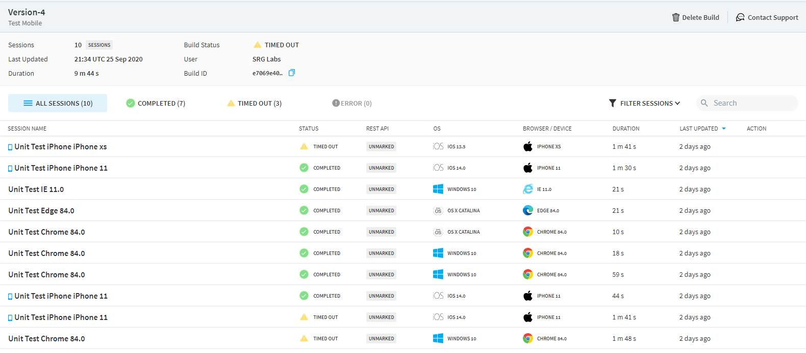
What did this look like?
Tests can now be ran in parallel to test all devices and browsers consistently
Screenshot is a device session within the Browserstack platform.

Slide 10
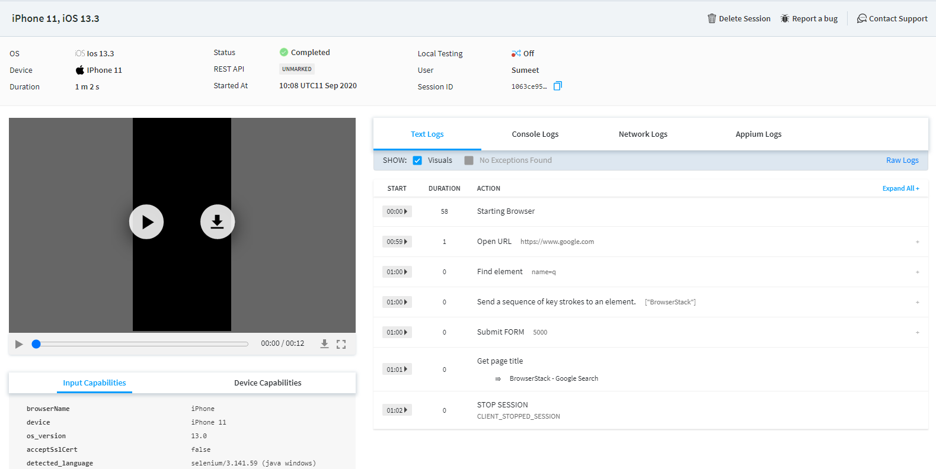
What did this look like?
Previously ran local testing scripts were now able to be pushed to device emulators
Screenshot is a device session within the Browserstack platform.

Slide 11

The Third Problem: no CICD integration
Now that we have the ability to create scripts and leverage cross-platform emulated testing capability we’re doing great.
However, one question still remained in my mind:
How close can we get this to the development and release lifecycles to deliver and provide an integrated QA process amidst a deployment?
Purr-plexing indeed

Slide 12
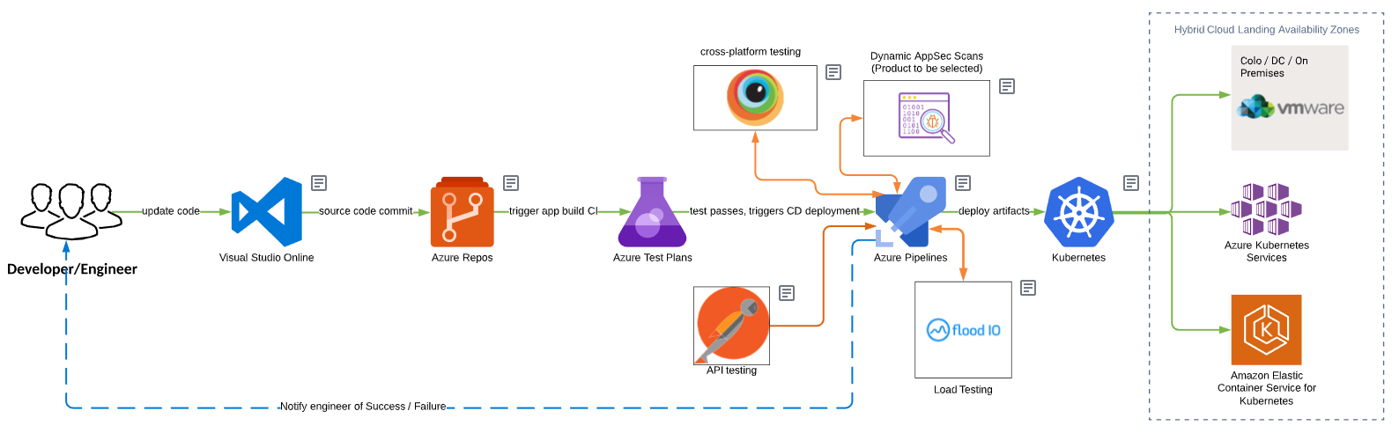
The Final Solution: QA + CICD Integration
By injecting automation in the pipeline, we can push tests prior to anything going to production

Slide 13
Prerequisites
A website URL link to test
Selenium
  Your test scripts
Azure DevOps
  A created project
  Repos should be enabled
  Pipelines should be enabled
A Browserstack account (trials available):
  Enabled for automate capability ($)
  Leveraging device capabilities
  Created access keys & credentials

Slide 14
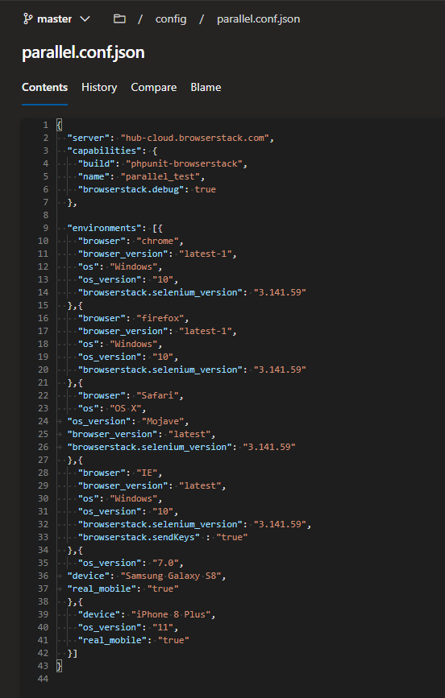
Establish devices to test

Slide 15
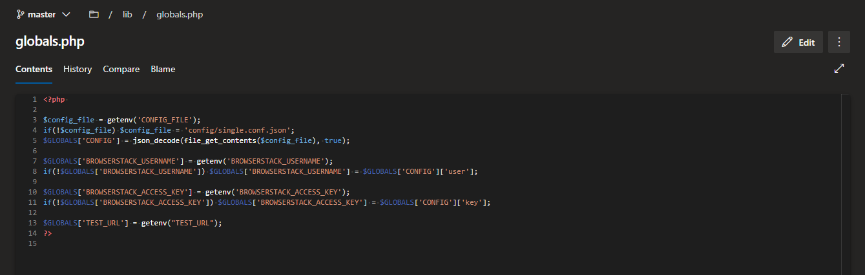
Configure your access connection

Slide 16
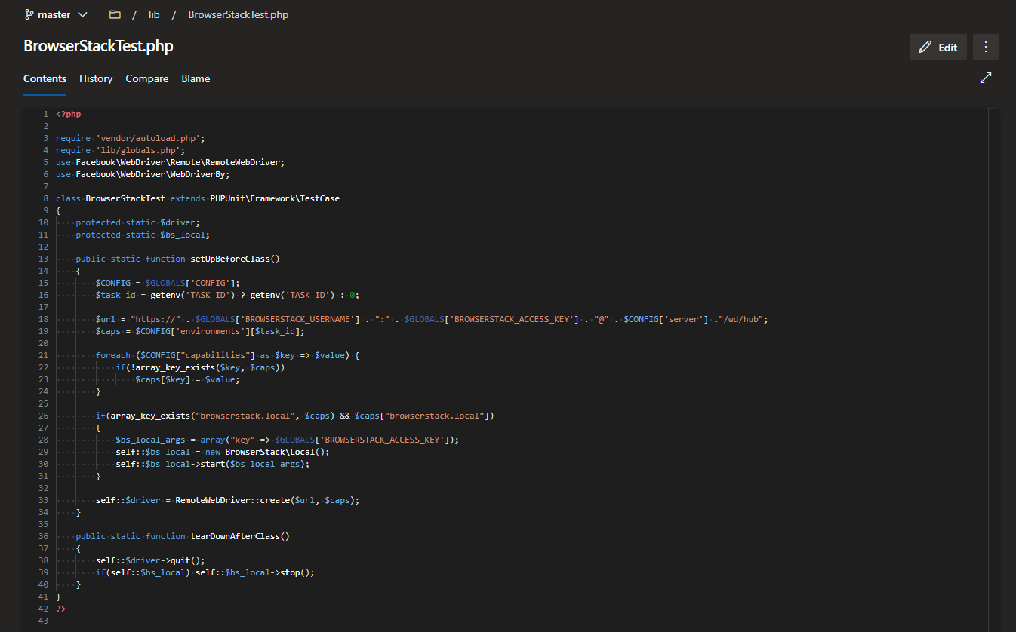
Connect access to credentials

Slide 17
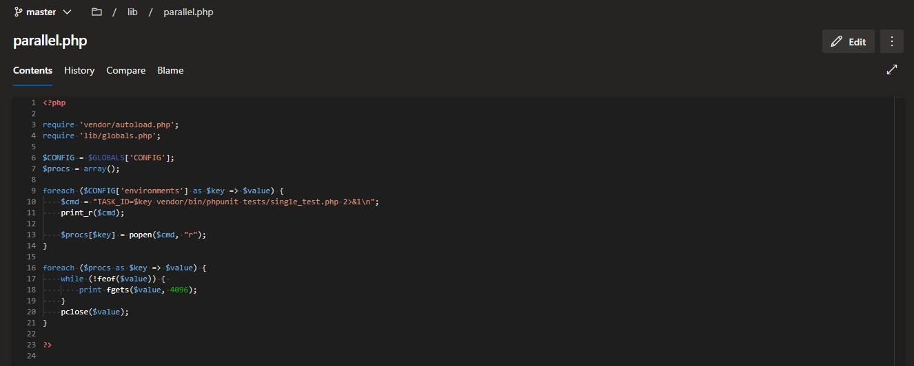
Configure your parallel test

Slide 18
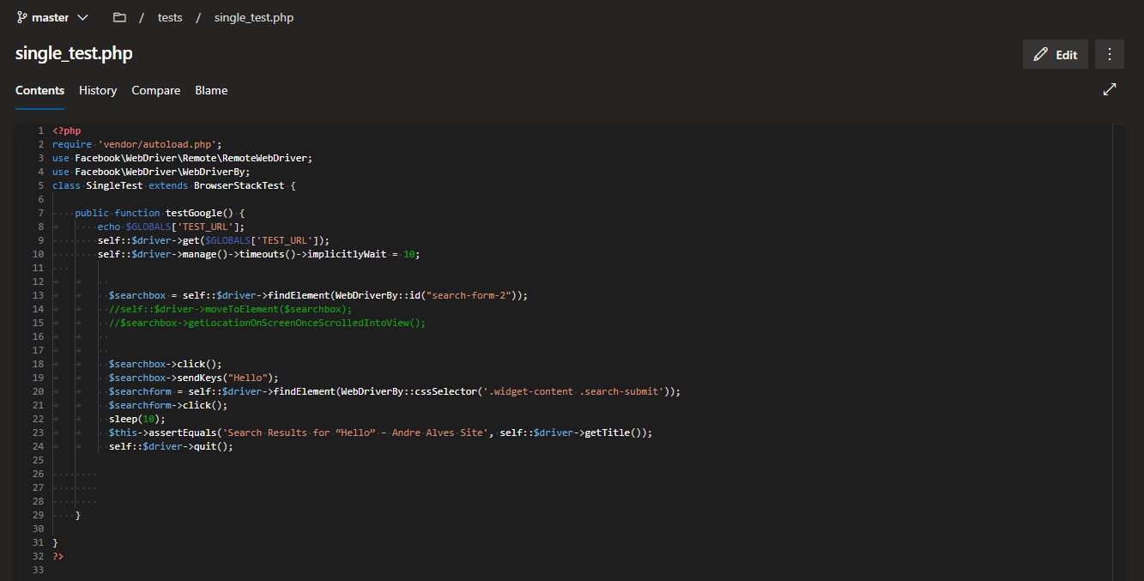
Configure what parallel runs

Slide 19
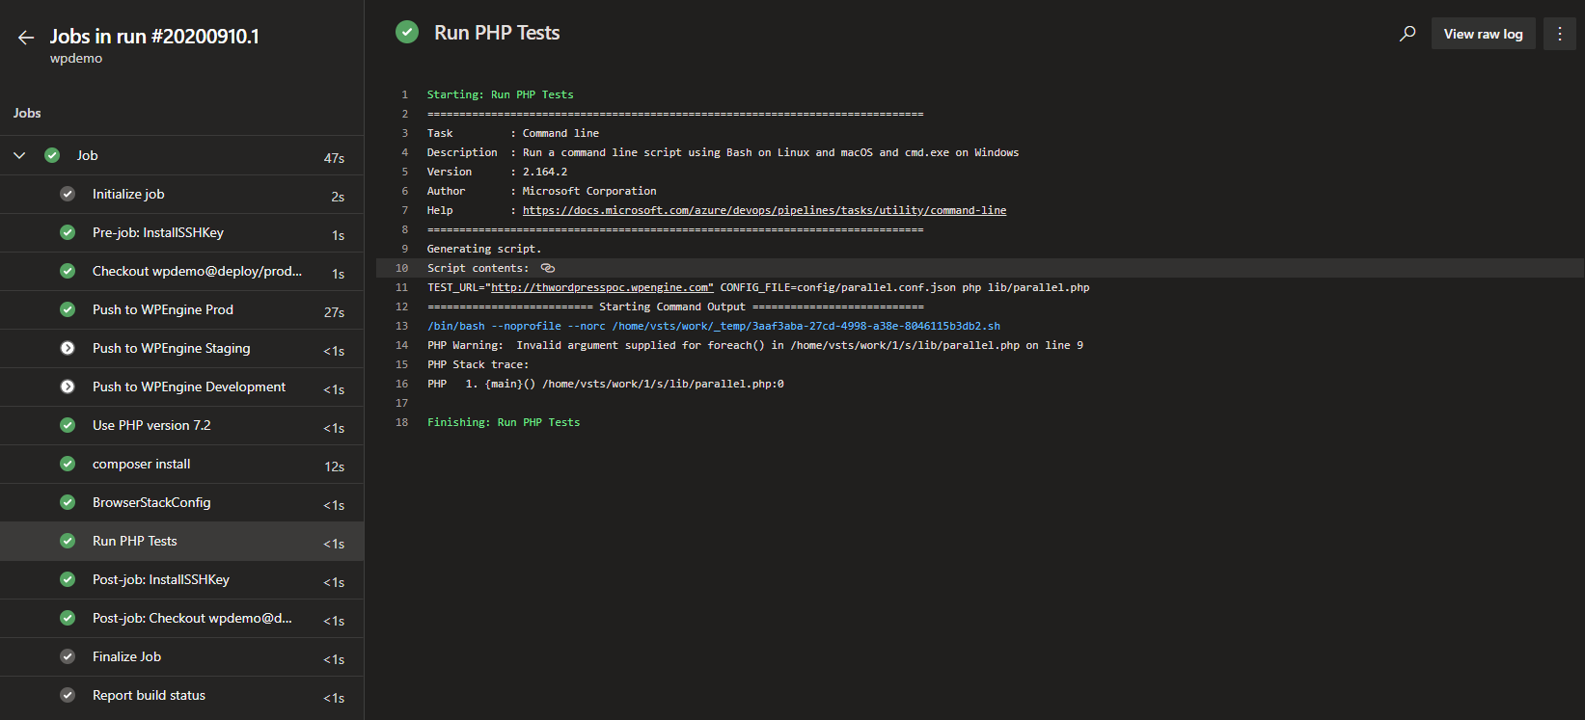
Run your azure devops pipeline with qa automation built in!

Slide 20
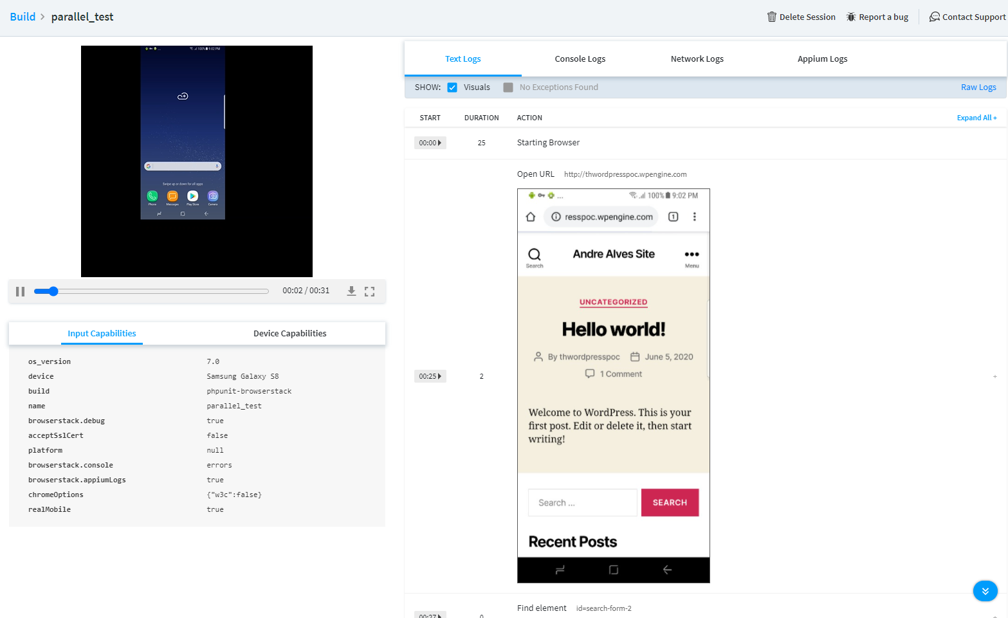
Validate your test results in browserstack

Slide 21
Closing thoughts
Test automation is an investment, and investments take time to produce worth. Focus on building out stable test environments before heavily investing in test automation.
Shifting to automated tests will offer the following positive outcomes:
  Enabling skills to be built in your team thus increasing the capacity, knowledge and capability
  Increasing team morale by automating tedious tasks and focusing on value adding activities such as exploratory testing
  Decreasing the duration of dev-test iterations when moving from serial manual tests to automated tests running in parallel
  Optimizing the cost of delivering a quality product

Slide 22
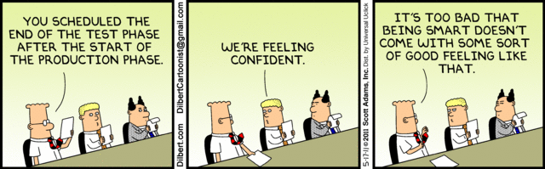
Thank you! I hope this was helpful ☺

